Slide 1
UPLIFTING FARMERS THROUGH A CONNECTED ECOSYSTEM
PIP2001 Capstone Project
Review-0
Batch Number : 17
Under the Supervision of,
Dr. Deepthi S
Assistant Professor
School of Computer Science and Engineering
Presidency University
Roll Number | Student Name
20211CAI0111 | Nidhi D
20211CAI0149 | Anil Kumar S
20211CAI0143 | Sandeep R
20211CAI0140 | Vignesh V
Name of the Program: B. Tech
Name of the HoD: Dr. Zafar Ali Khan
Name of the Program Project Coordinator: Dr. Afroz Pasha
Name of the School Project Coordinators: Dr. Sampath A K / Dr. Abdul Khadar A / Mr. Md Ziaur Rahman

Slide 2
Content
Problem Statement
Analysis of Problem Statement
Timeline of the Project
References

Slide 3
Problem Statement Number: 98
Organization: Mahindra&Mahindra (FarmEq)
Category : Software – Mobile Application Development
Problem Description: How can a farmer gain access to all the elements of his farming cycle? One stop shop where he has access to information from different aggregators, for retailing, leasing & finally taking his produce to the nearest mandi. Application to provide a means of easy transaction for all his farming activities and his personal expenses. Agri credit should help him buy/lease Farm Machinery & have access to all the local vendors for his plantation needs including expert advice from the local university.
Difficulty Level: Complex

Slide 4
Analysis of Problem Statement
Technology Stack Components:
Java – Primary language for building Android apps.
Android SDK – Tools and libraries for Android development.
Node.js – For building the back-end (server-side logic) in JavaScript.
Express.js – A framework for building REST APIs in Node.js.
MongoDB – NoSQL database for handling unstructured data.
UPI Integration – For seamless payment and transfer within the app (India-specific).
Firebase – For real-time database, authentication, and cloud storage.
GitHub – For automating builds and deployment.

Slide 5
Analysis of Problem Statement (contd...)
Software Requirements:
Operating System - Windows 10/11 (8GB RAM Minimum)
JDK 11 or higher for Android development with Kotlin
Android Studio: The official IDE for Android development.
Git: For source code management and version control
NodeJS and ExpressJS for Backend Development
MongoDB : For Database Management Systems
Firebase: Real-time database
Docker: For containerizing your back-end services (Node.js, databases, etc.) for easier deployment across environments.

Slide 6
Analysis of Problem Statement (contd...)
Centralized Access to Farming Resources: The solution seeks to create a one-stop platform where farmers can access aggregators for retailing, leasing, and selling produce, thereby streamlining their operations and reducing dependency on middlemen.
Financial Inclusion through Agri-Credit: The app proposes easy access to agri-credit, enabling farmers to finance equipment leasing, purchase inputs, and manage personal expenses, addressing the critical issue of limited access to formal financial systems in rural areas.
Expert Agricultural Advice: By connecting farmers with local university experts, the platform offers real-time, data-driven insights on farming practices, which could improve crop yield and promote sustainable agriculture.

Slide 7
Analysis of Problem Statement (contd...)
Digital Literacy and Connectivity Challenges: Successful implementation depends on overcoming barriers such as low digital literacy and poor internet connectivity in rural areas, which might limit adoption of the app.
Complex Integration of Stakeholders: The solution is complex due to the need to integrate multiple stakeholders (vendors, experts, financial institutions) across different regions, all within a functional and user-friendly software ecosystem.

Slide 8
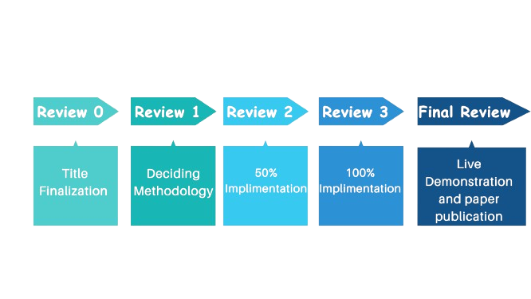
Timeline of the Project (Gantt Chart)

Slide 9
References (IEEE Paper format)
Altieri, M. A. (2004). Linking ecologists and traditional farmers in the search for sustainable agriculture. Frontiers in Ecology and the Environment, 2(1), 35-42.[1]
Swinton, S. M., Lupi, F., Robertson, G. P., & Hamilton, S. K. (2007). Ecosystem services and agriculture: Cultivating agricultural ecosystems for diverse benefits. Ecological economics, 64(2), 245-252.[2]
Kremen, C., & Miles, A. (2012). Ecosystem services in biologically diversified versus conventional farming systems: benefits, externalities, and trade-offs. Ecology and society, 17(4).[3]
Altieri, M. A., Funes-Monzote, F. R., & Petersen, P. (2012). Agroecologically efficient agricultural systems for smallholder farmers: contributions to food sovereignty. Agronomy for sustainable development, 32(1), 1-13.[4]
Yadav, A., Thilagam, P., & Singh, S. (2023). Mobile applications for agricultural transformation: Types, impacts, case studies, and recommendations.[5]

Slide 10
RASHID, S. M. (2014). Empowering farmers through e-Agriculture (Doctoral dissertation, DEPT. OF AGRICULTURAL EXTENSION & INFORMATION SYSTEM).[6]
Lesaona-Tshabalala, B. V. (2001). Agricultural information needs and resources available to agriculturists and farmers in a developing country with special reference to Lesotho. Disertation. Dept. of Information Studies, Faculty of Arts, Rand Afrikaans University.[7]
Madaswamy, M. (2020). Digitalization of agriculture in India: Application of IoT; robotics and informatics to establish farm extension 4.0. Journal of Informatics and Innovative Technologies, 4(2), 23-32.[8]
Khan, A., Khan, F., & Thakre, P. (2020). Uplifting Farmers Through Connected Ecosytem.[9]
Mammo, Y. (2015). ICTs in linking farmers to markets: Innovative mobile applications and lessons learned from the past and the future. CTA.[10]

Slide 11


